Slide 1
IT 106: Introduction to IT Problem Solving Using Computer Programming
Module 1a
Introduction to Problem Solving

Slide 2
In This Lecture
Beginning of Course Content
Steps in Program Development
Program Design Methodology
Introduction to Algorithms and Pseudocode
Running Computer Programs

Slide 3
Steps in Program Development

Slide 4
Step 1: Define the Problem
We develop programs because we are trying to solve problems
Define the problem into three components (Remember: IPO)
Inputs – What do we have to specify?
Processing – What steps have to occur to solve the problem and produce desired output?
Outputs – What do we expect to be output that will solve the problem?

Slide 5
Step 2: Outline the Solution
Problems, especially complex ones, are typically not immediately solved, so we need to outline the solution
Decompose the problem into smaller steps
Establish a solution outline
Initial outline may include
Major processing steps involved
Major subtasks
User Interface
Major Control Structures
Major Variable and Record Structures
Business process logic
The "what"
The "how"

Slide 6
Step 3: Develop the Outline into an Algorithm
The solution outline is expanded into an algorithm
A set of precise steps that describe exactly what tasks need to be performed and their order in which they are to be carried out.
Can be represented in multiple ways:
Pseudocode
Flowcharting

Slide 7
Step 4: Test the Algorithm for Correctness
Testing is arguably the most crucial step in program development
Often forgotten or left until its too late
Major program errors can be detected and corrected at an early stage
Helps to find logic errors
Go through the algorithm step-by-step with test data to ensure the program will actually do what it is supposed to do

Slide 8
Step 5: Code the Algorithm
This only occurs after steps 1-4 have been completed
Helps to ensure a well-designed solution
At this point, we start to code the algorithm within a specific programming language

Slide 9
Step 6: Run the Computer Program
After the program has been coded, depending on the language, a compiler is used to translate the human-readable code into machine-readable code
Tests for syntax (compiler) errors
Upon running the program, re-test the algorithm
Watch for run-time errors
Example: Divide by zero

Slide 10
Quick Recap of Types of Errors
Syntax error
Violating the rules of the language
Example: Missing a semi-colon at the end of the statement
Logic error
Not a syntax error, but an error in how the program should process the data
Runtime error
Unexpected error that only happens when the program is running that crashes the program
Example: divide by zero

Slide 11
Step 7: Document and Maintain the Program
Documentation is another crucial step often forgotten
Includes external documentation
Describes the purpose of the program, its inputs and outputs
Includes internal documentation
Describes the purpose of subtasks within the program itself

Slide 12
Questions?

Slide 13
Program Design Methodology

Slide 14
Overview of Program Design Methodology
Some approaches to program design include:
Procedure-driven
Event-driven
Data-driven
Object oriented

Slide 15
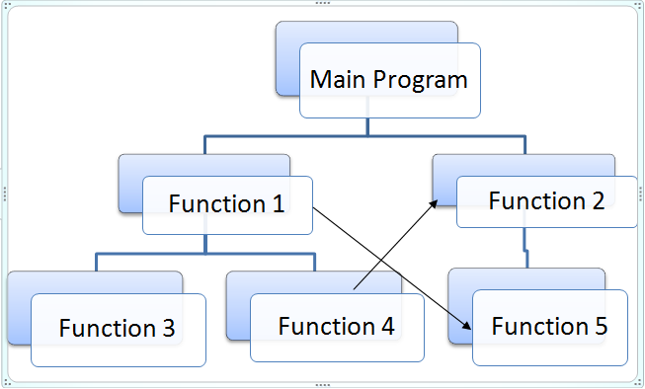
Procedure-Driven Program Design
Based on the idea that the most important feature of a program is what it does
Data moves, in order, from one process to another, until the program is complete

Slide 16
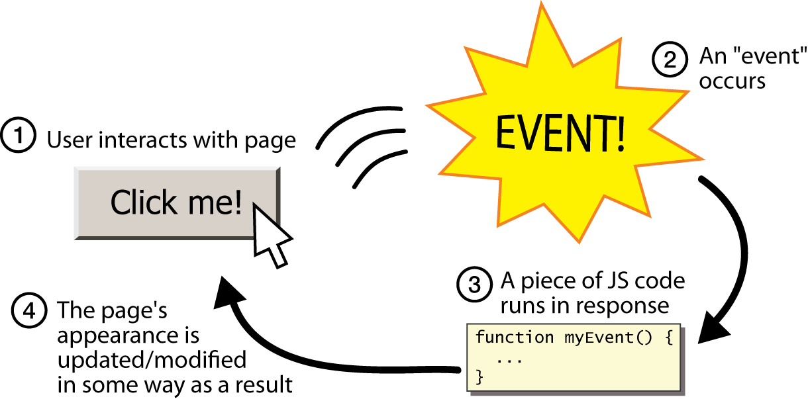
Event-Driven Program Design
Based on the idea that events or interactions cause programs to change from one state to another
Example: JavaScript for HTML buttons

Slide 17
Data-Driven Program Design
Based on the idea that the data in a program is more stable than the processes involved
First, analyze the data and relationships between the data
Then, figure out what processes are needed to convert data input into expected output

Slide 18
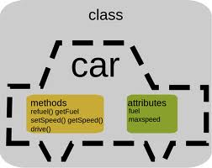
Object-Oriented Program Design
Based on the idea that a program can be broken down into "things" (objects) that can interact with each other

Slide 19
Procedural vs. Object-Oriented Programming
Procedural programming concentrates on what a program has to do by organizing the processes to yield expected output
Usually broken down into separate tasks
Top-down development
Modular design

Slide 20
Procedural vs. Object-Oriented Programming (Cont'd)
Top-down Development
aka functional decomposition or stepwise refinement
The general solution to the problem is outlined
More detailed steps are derived until the lowest level of detail is understood
Very systematic approach to program design
A then B then C, etc.

Slide 21
Procedural vs. Object-Oriented Programming (Cont'd)
Modular Design
Connected with top-down development
However, tasks can be logically grouped together
Each group does one thing, but really well (e.g. a factory assembly line)
Assists in the reading and understanding of the program

Slide 22
Procedural vs. Object-Oriented Programming (Cont'd)
Object-Oriented Programming
Breaks down the problem based on the "things" that make up the program
Within a program, a set of separate objects perform actions that relate to each other
Example: A STUDENT registers for a COURSE

Slide 23
Questions?

Slide 24
Introduction to Algorithms and Pseudocode

Slide 25
What is an Algorithm?
What is an algorithm?
Lists the steps involved in accomplishing a task (like a recipe)
"A set of detailed and ordered instructions developed to describe the processes necessary to produce the desired output from a given input"
An algorithm must
Be lucid, precise, and unambiguous
Give the correct solution in all cases
Remember all the testing needed for this
Have a start and an end

Slide 26
What is Pseudocode?
"Fake code"
Structured English (formalized and abbreviated to look like a high-level computer language)
Used to write out programs before coding
Example Pseudocode
1 Prompt user for length
2 Read length
3 Prompt user for width
4 Read width
5 Set area = length * width
6 Output area

Slide 27
Program Data
Three main types of program data
Variable
A value stored in memory that may change while a program executes
Example: x = 3
Constant
A data item with a name and value that remains the same while a program executes
Example: VOTING_AGE
Literal
A constant whose name is the written representation of its value
x = 3

Slide 28
Data Types
Data types can be
Elementary
Contains a single variable that is always treated as a unit
Examples: integer, character
Complex/Data Structure
An aggregate of other data items
The data is grouped in a particular way
Examples: string, array, record, file

Slide 29
Data Validation
Data should always undergo a validation check before it is processed by a program
Examples:
Correct type
Correct range
Correct length
Completeness
Correct date

Slide 30
Questions?

Slide 31
Running Computer Programs

Slide 32
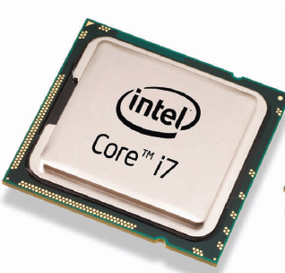

Anatomy of a Computer
From IT-103….
Central Processing Unit (CPU)
Performs program control and data processing
Storage devices include memory (RAM) and secondary storage
Hard disk, flash drives, CD/DVD drives
Input/Output devices allow the user to interact with the computer
Mouse, keyboard, printer, screen

Slide 33
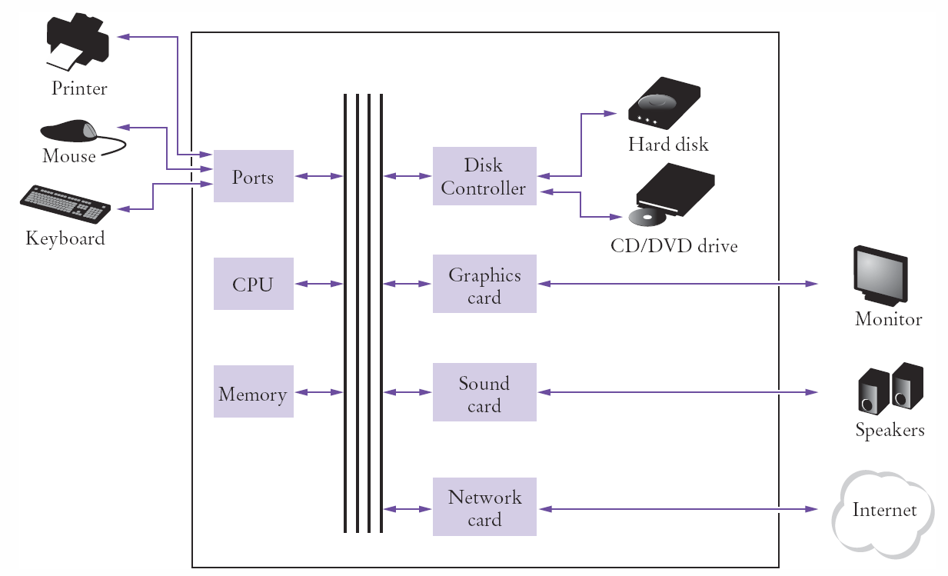
Schematic Design of a PC

Slide 34
"Running" a Program
Program instructions and data (e.g. text, numbers, audio, etc.) are stored on a storage device (e.g. hard drive, DVD, etc.) locally or on a network
Once the program is started, it is brought into memory where the CPU can read it
The CPU runs the program one instruction at a time
The program may react to user input
As directed by the instructions and user, the CPU reads/modifies/writes data back to memory, the screen, or storage

Slide 35
Questions?

